Slide 1


Sensitivity of Soil Water Holding Capacity
to Methods of Spatial Interpolation
Michael Felzan

Slide 2
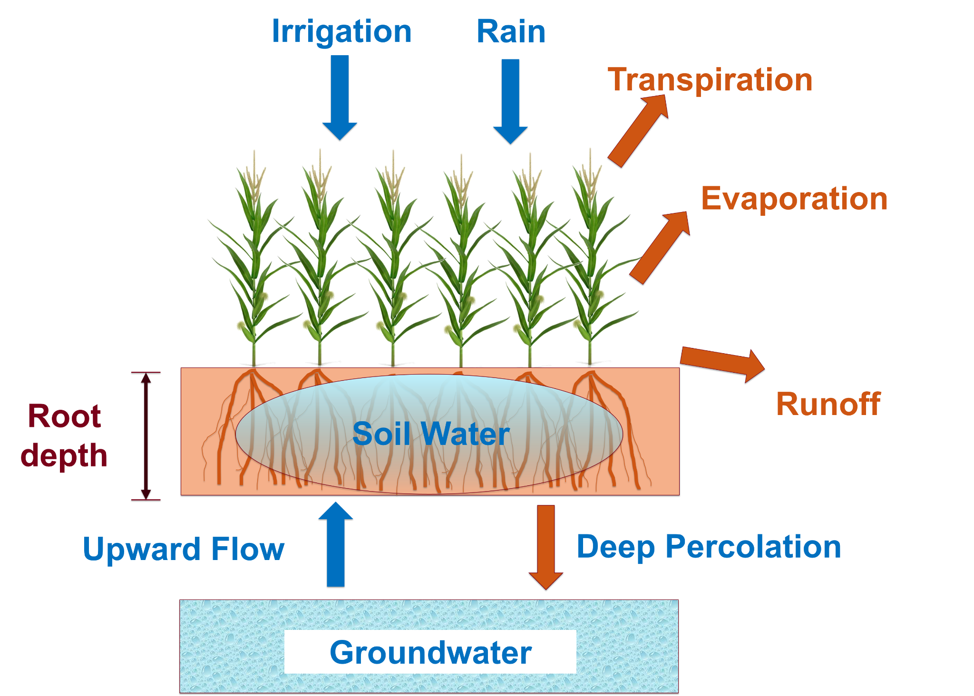
Background: Irrigation
Notes:
Irrigation involves applying the optimal amount of water to a crop field
Different crops have different root depths and abilities and tolerances for water. Irrigation amounts are adjusted for different crop types
If we think of soil water as a bucket, there are many variables acting as water inputs and outputs to//from that bucket

Slide 3
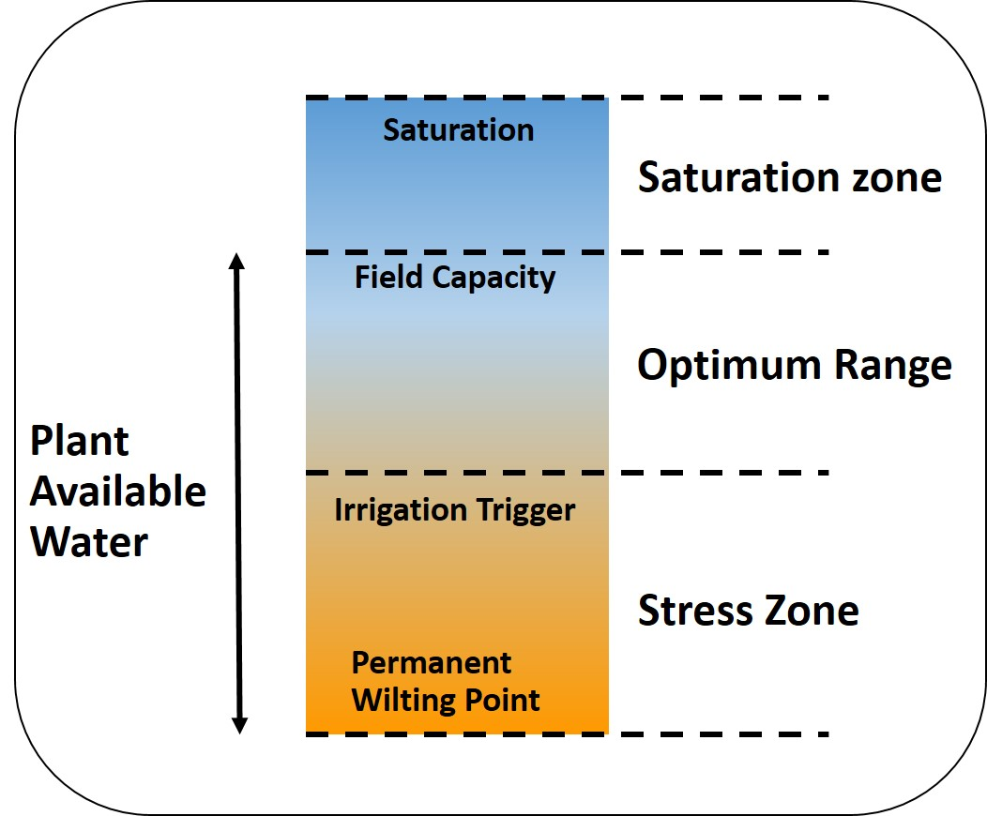
Background: Irrigation
The goal of irrigation is to keep soil water levels in the optimal range. This range is between:
The point of crops becoming ‘stressed’ due to not enough water
The field’s point of saturation where any additional water will be wasted, field can’t hold any more
The work of the LCCMR Irrigation Management Assistant project is to approximate the levels of irrigation that should be applied to a field throughout a growing season.

Slide 4
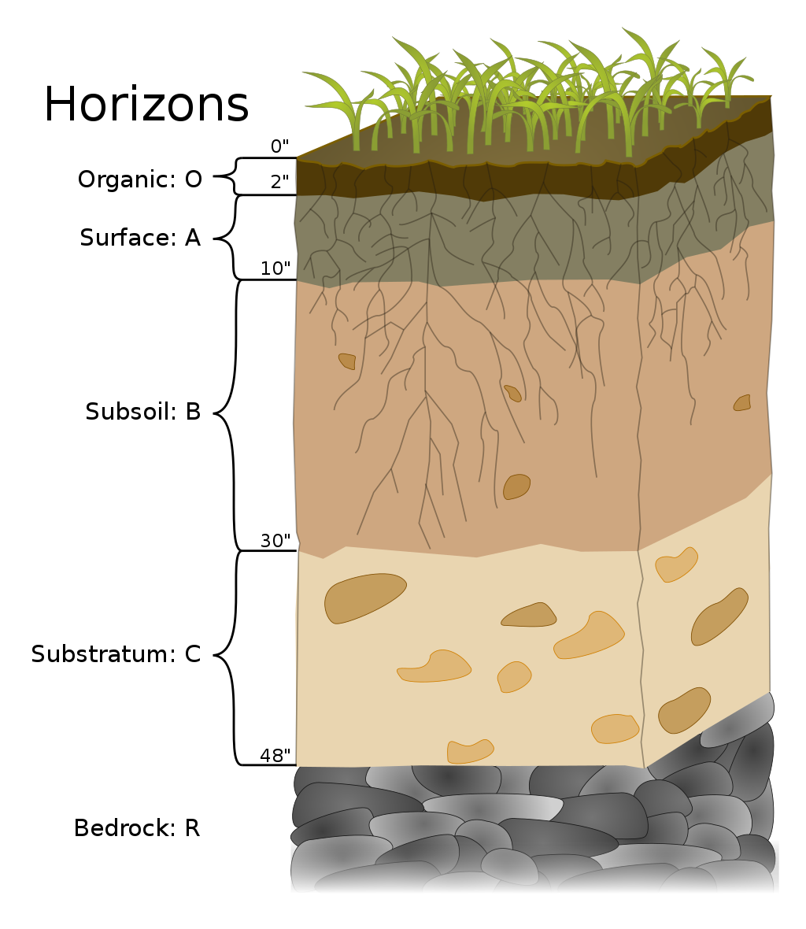
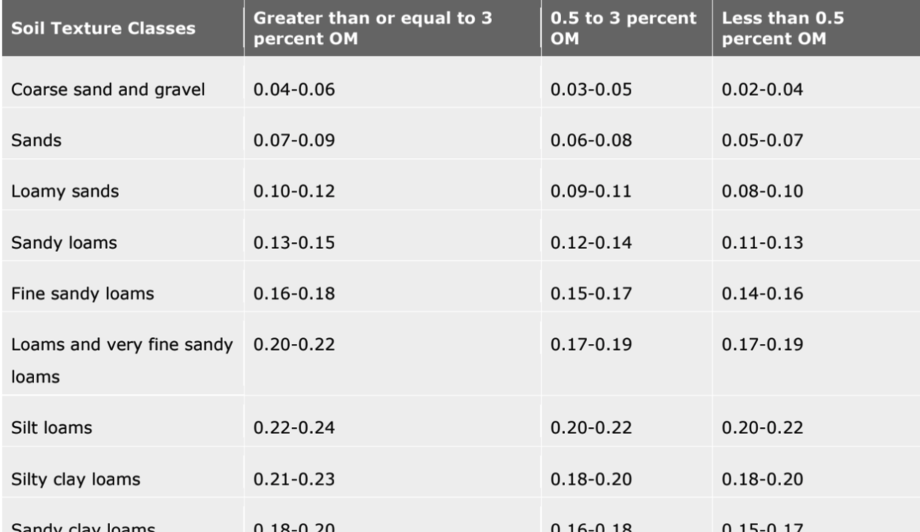
Background: Soil
Available Water Capacities in Centimeters per cm of Soil
Notes:
-Soils are conventionally broken down into discrete horizons, based on soil composition
-Horizons are not always at same depth intervals

Slide 5
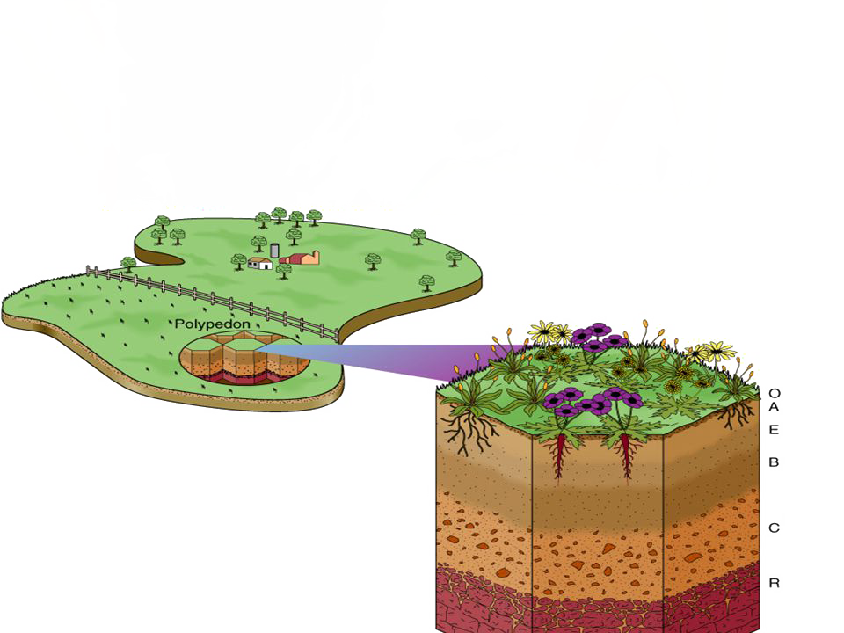
Background: Soil
Many horizons within a single pedon (3-D vertical soil unit)
Soil series are made up of pedons of similar characteristics and arrangement in soil profile
Components are generally phases of soil series that enable the most precise interpretation.
Soil Series
Horizons
Pedon

Slide 6

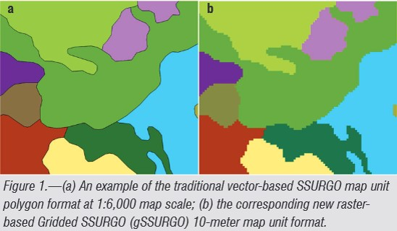
Background: SSURGO
Soil Survey Geographic (SSURGO) Database
Available via USDA-NRCS (Natural Resources Conservation Service)
Highly detailed tabular soil data
Data developed by the National Cooperative Soil Survey (NCSS)
Data represents soil attributes, derived from National Soil Information System (NASIS)
“Gridded SSURGO” (gSSURGO) is similar to standard USDA-NRCS SSURGO Database product but in the format of an ESRI® file geodatabase
Contains data in raster format
gSSURGO Database

Slide 7
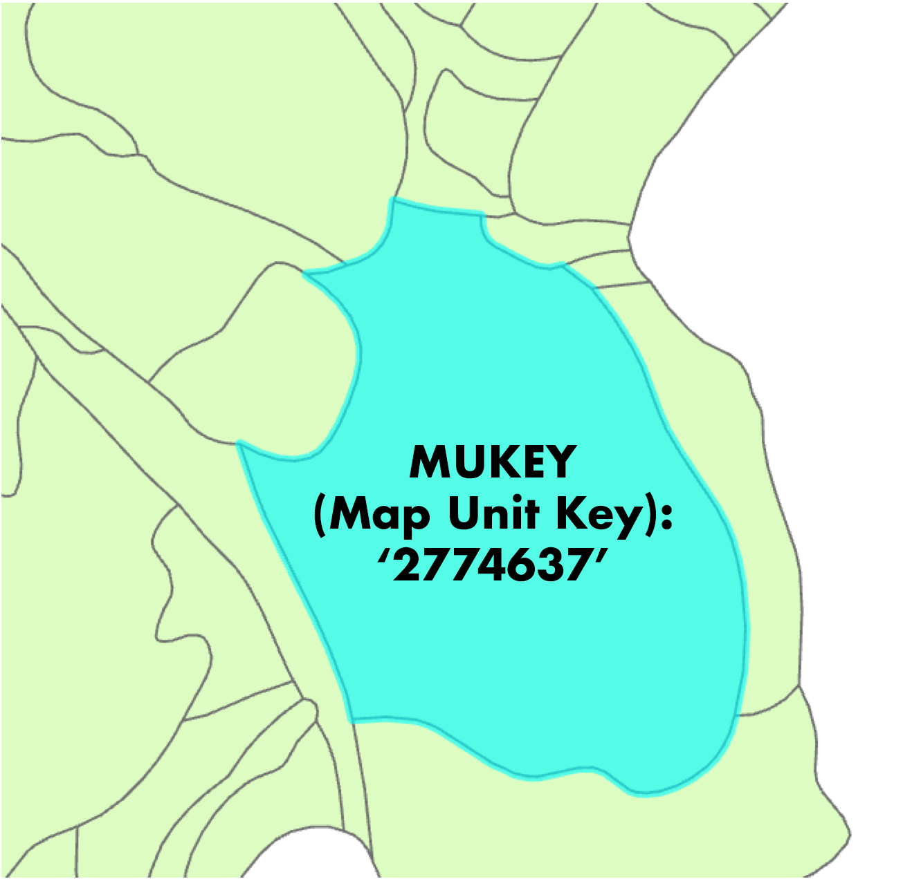
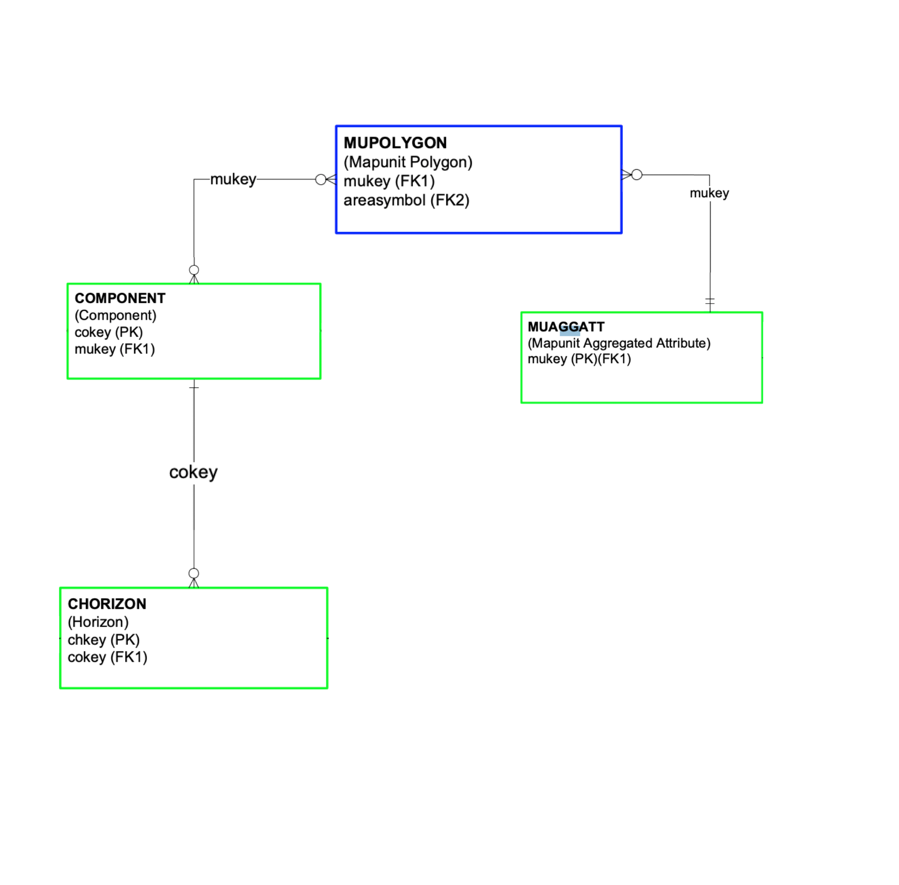
Background: SSURGO
gSSURGO Data Structure
MapUnit Polygon : Component = 1:Many relationship
Component : Horizon = 1:Many relationship

Slide 8
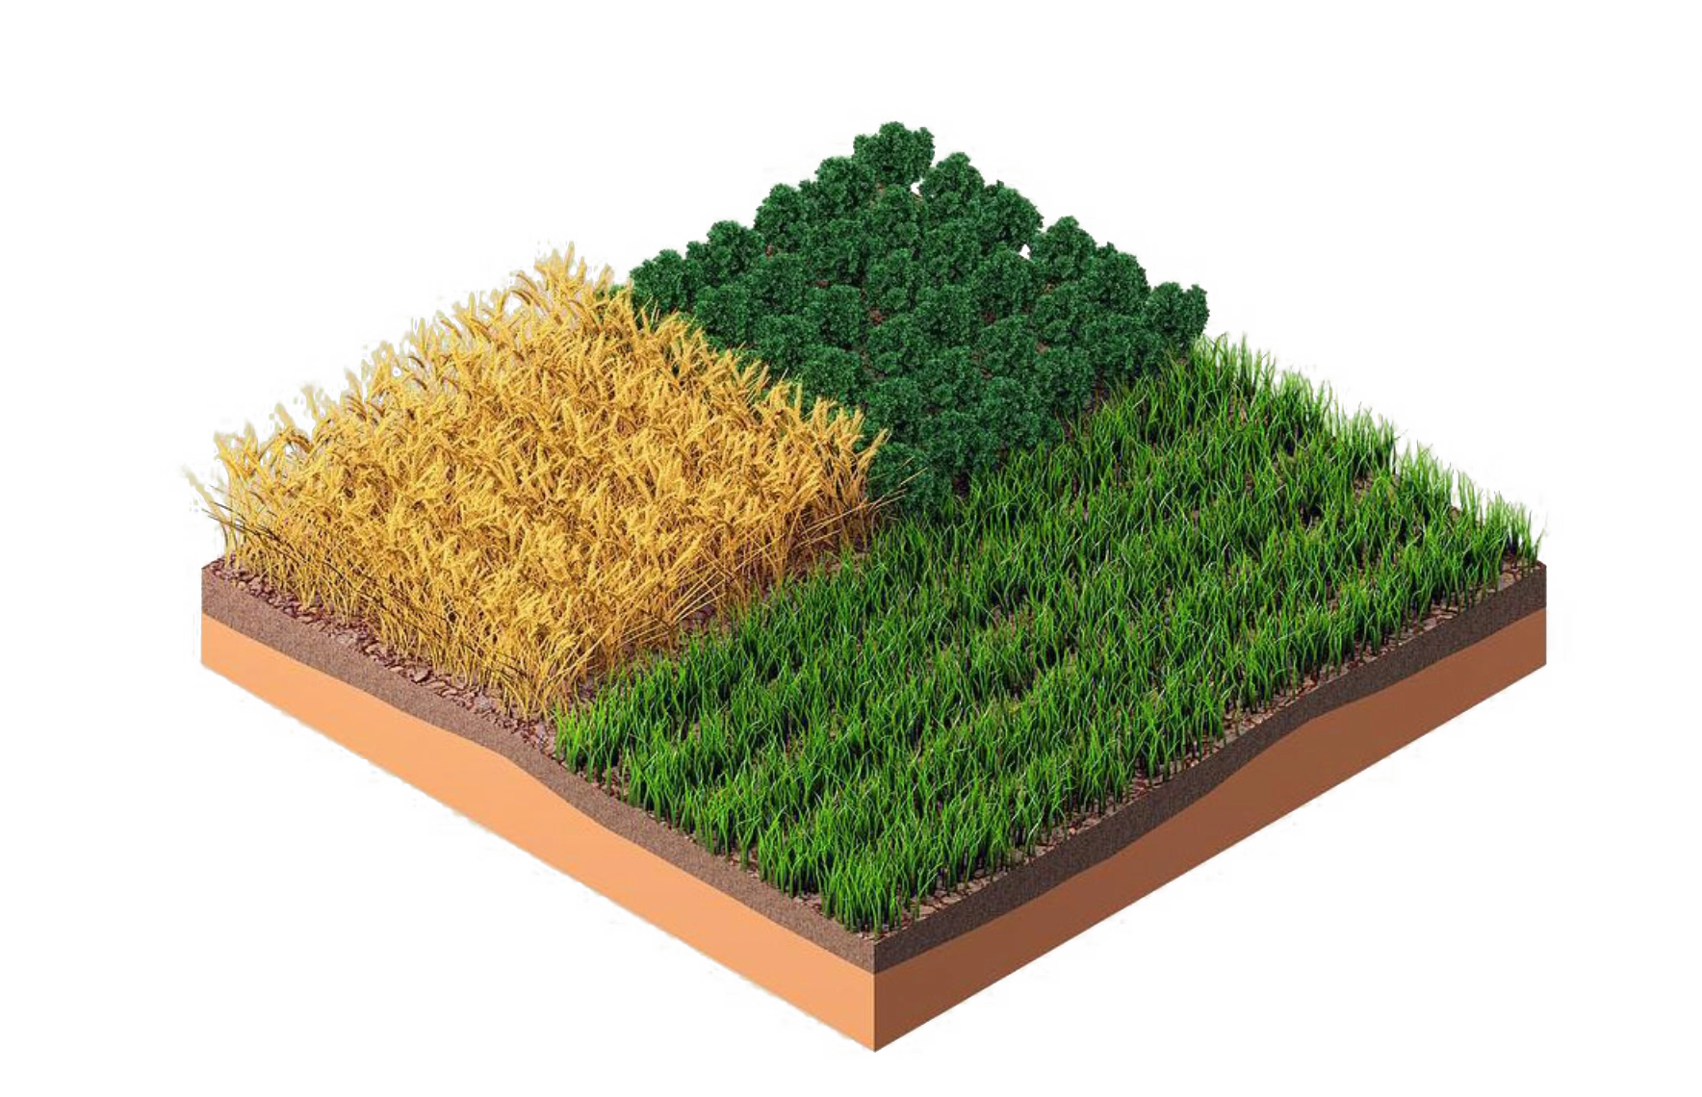
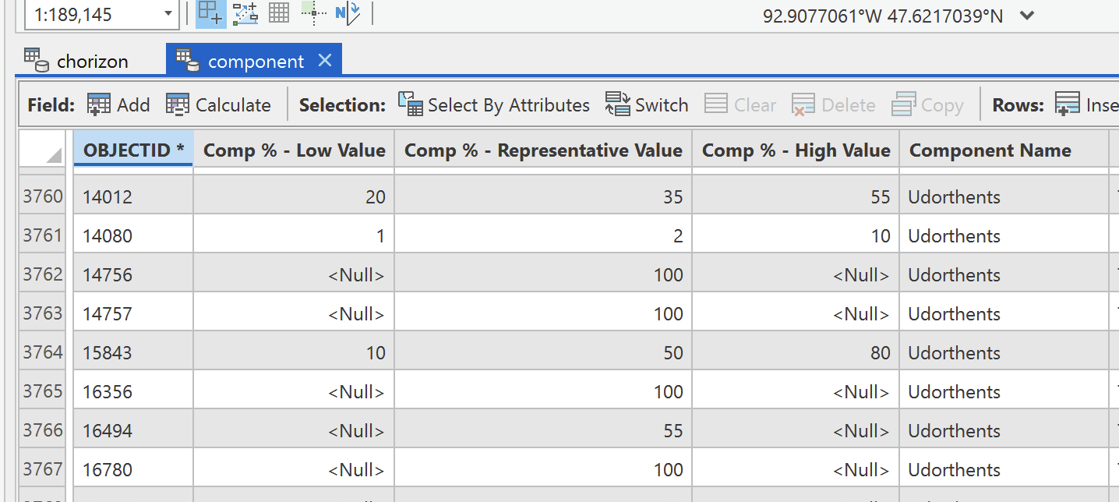
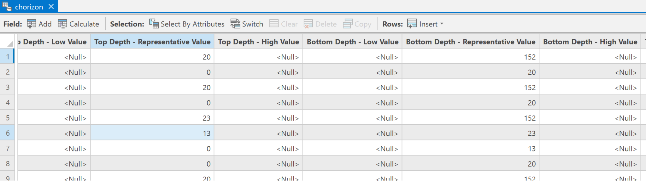
Project Overview: Irrigation Management Assistant Tool
Moving from:
to:
SSURGO input data tables
Field-level soil water holding capacity
?

Slide 9
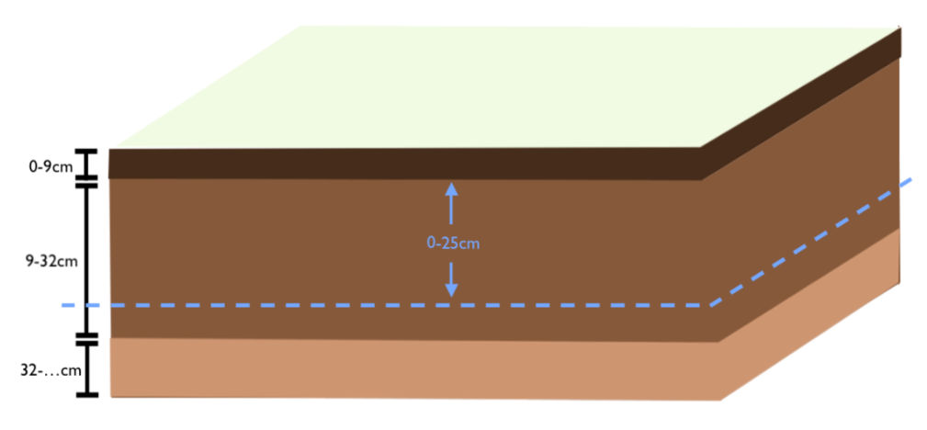
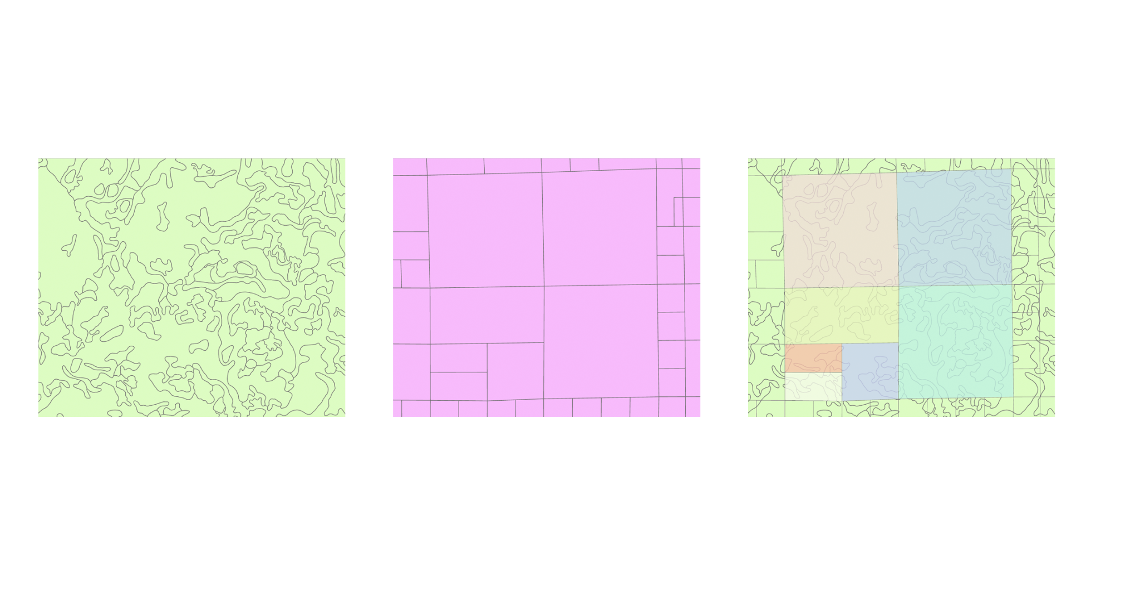
Main Research Objectives
Objective 1. Determine how SSURGO summarizes map unit Available Water Capacity (AWC) at their four reported depth intervals (0-25cm, 0-50cm, 0-100cm, 0-150cm), so method may be applied to any arbitrary depth X to X₂ using soil component/horizon attributes in SSURGO
AWC_{X1-X2}
Objective 2.
Characterize variability between spatial summarization methods (?,?,?) for estimating field-level AWC (for 0-24, 24-48in, etc.) from map-unit-level AWC from MUAGGATT table for AWS 0-25in, etc.

Slide 10
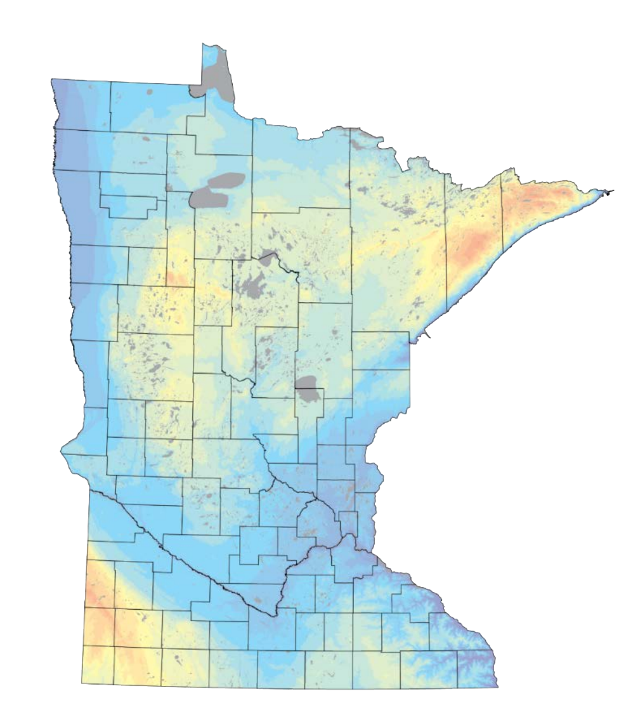
Expected Outcomes
AWS estimates (min and max)
Objective 1.
0-12in
12-24in
24-36in
36-48in
Objective 2.
Amount of Variance between methods
Parcel ID | IDW AWS | Area Weighted AWS | <Heuristic> AWS | Parcel Size (acres)
1 | … | … | … | …
2 | … | … | … | …
3 | … | … | … | …
Parcel ID | IDW AWS | Area Weighted AWS | <Heuristic> AWS | Parcel Size (acres)
1 | … | … | … | …
2 | … | … | … | …
3 | … | … | … | …
. . .
0-25cm
0-50cm

Slide 11

Additional Project Deliverables
Python wrapper tool for accessing SSURGO easily
Python Jupyter Notebooks documenting all steps/parameters used in process
Jupyter Notebook which takes spatial interpolation algorithm and soil depth interval as user inputs to calculate AWS

Slide 12
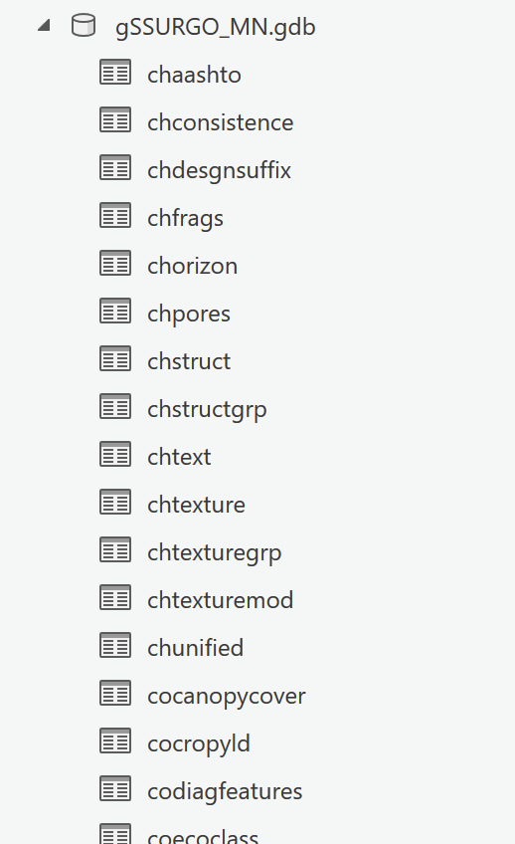
Objective 1. Input Data
‘‘CHORIZON’ table within gSSURGO
“COMPONENT” table within gSSURGO
(“MUGGATT” table within gSSURGO)

Slide 13
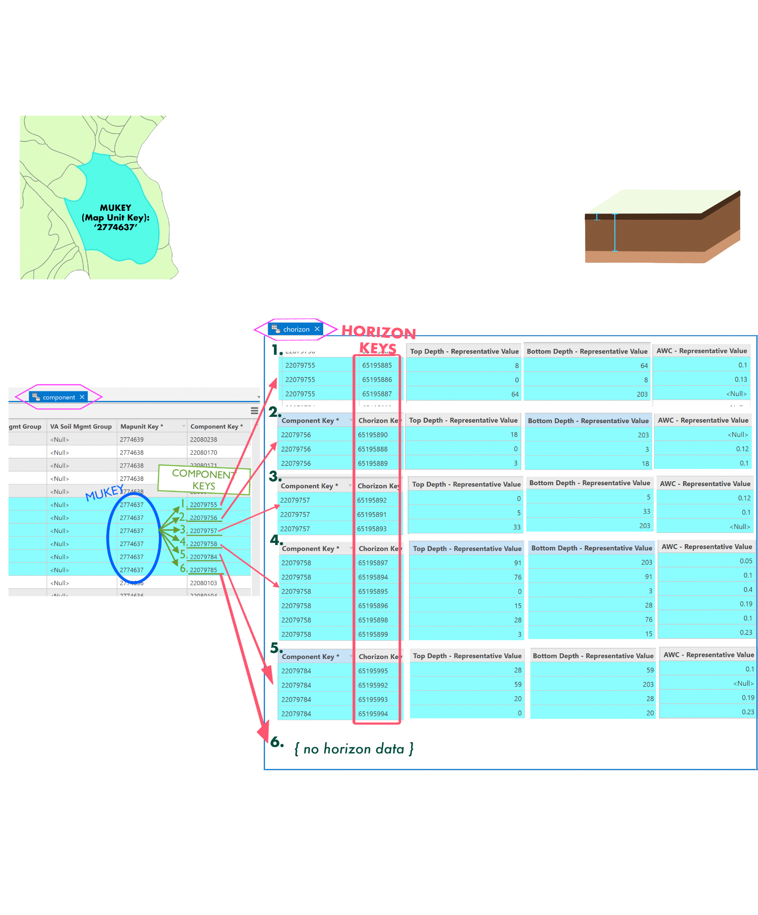
Objective 1. Input Data

Slide 14
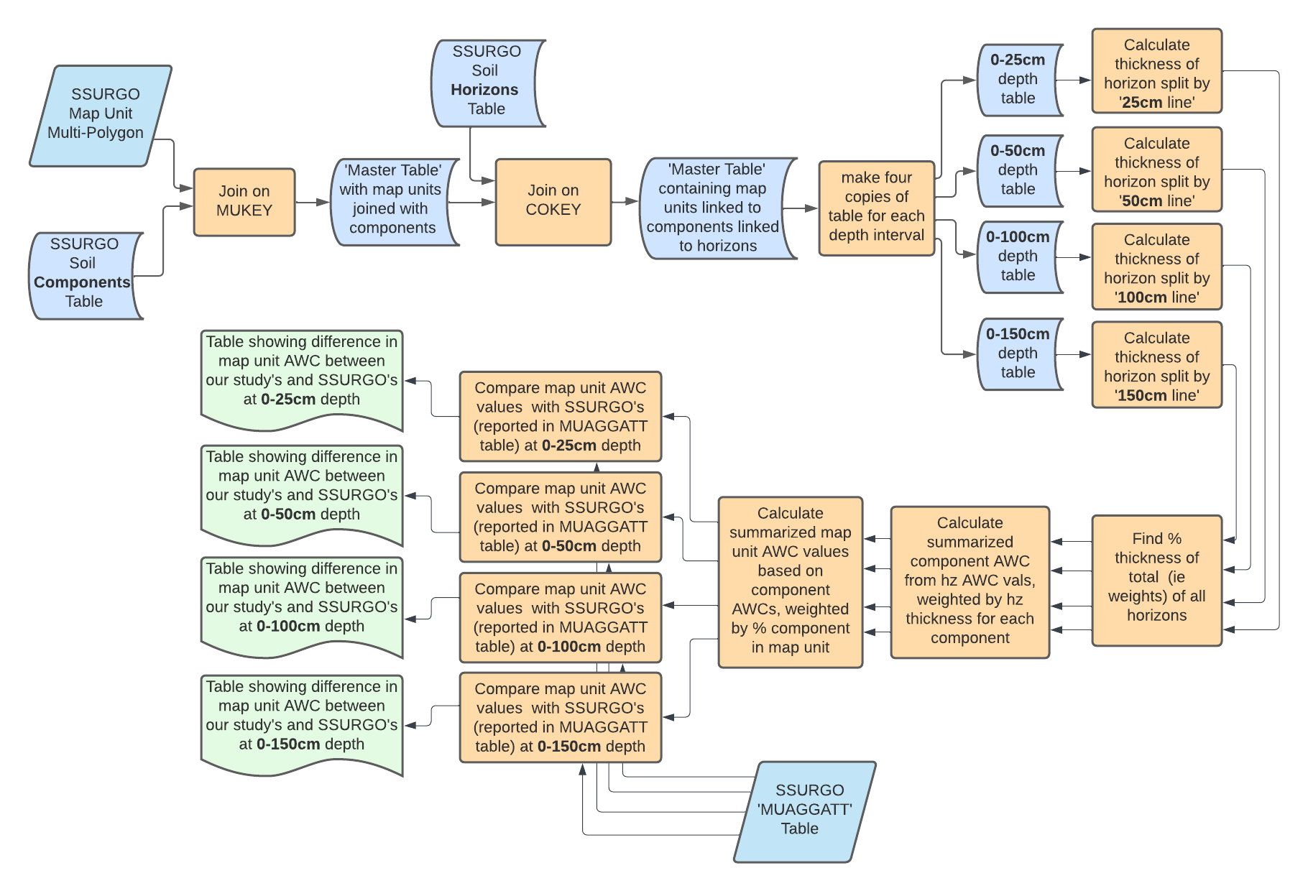
Objective 1. Methodology

Slide 16
gSSURGO Data Structure
MapUnit Polygon : Component = 1:Many relationship
Component : Horizon = 1:Many relationship

Slide 17
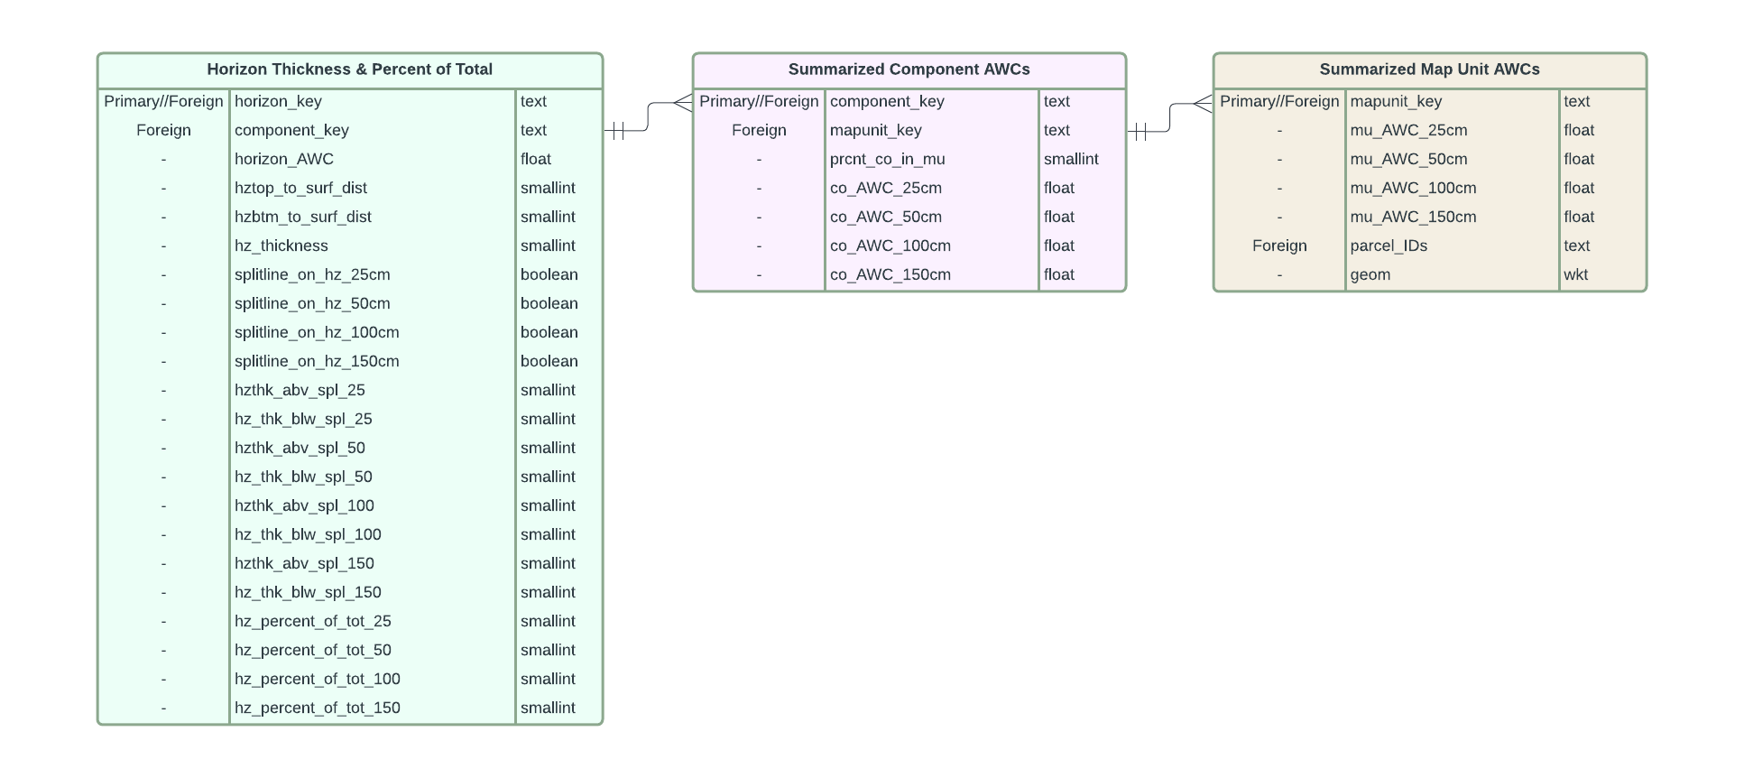
Objective 1. Methodology

Slide 18
Objective 1. Expected Outcomes
AWS estimates (min and max)
Documentation of the (probable) processes used by SSURGO to summarize AWS for mukey polygons at given soil depth intervals using the SSURGO “component” and “horizon” tables
Calculation of minimum and maximum AWS values (between various interpolation algorithms) specifically at the depth intervals of 0-12in, 12-24in, 24-36in, and 36-48in
Associated map visualizations of these findings
0-12in
12-24in
24-36in
36-48in

Slide 19
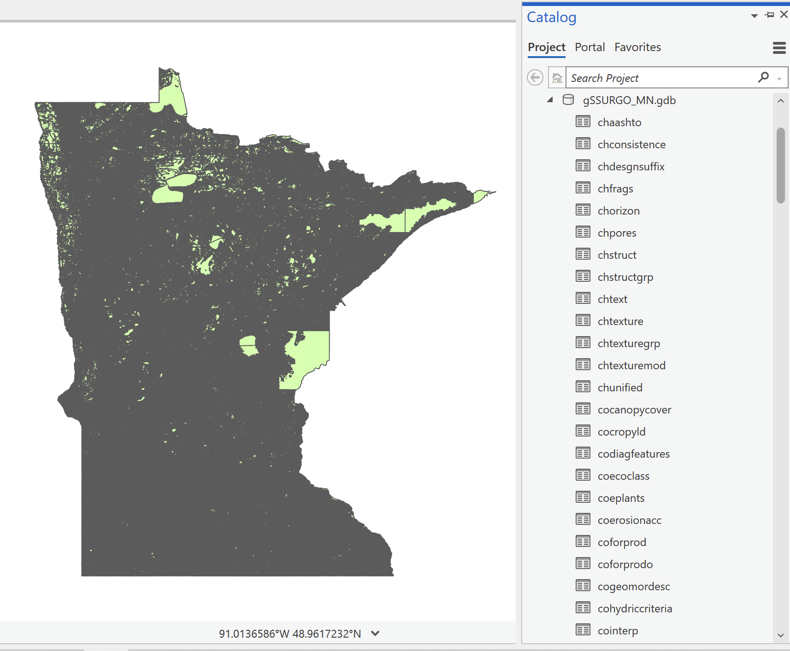
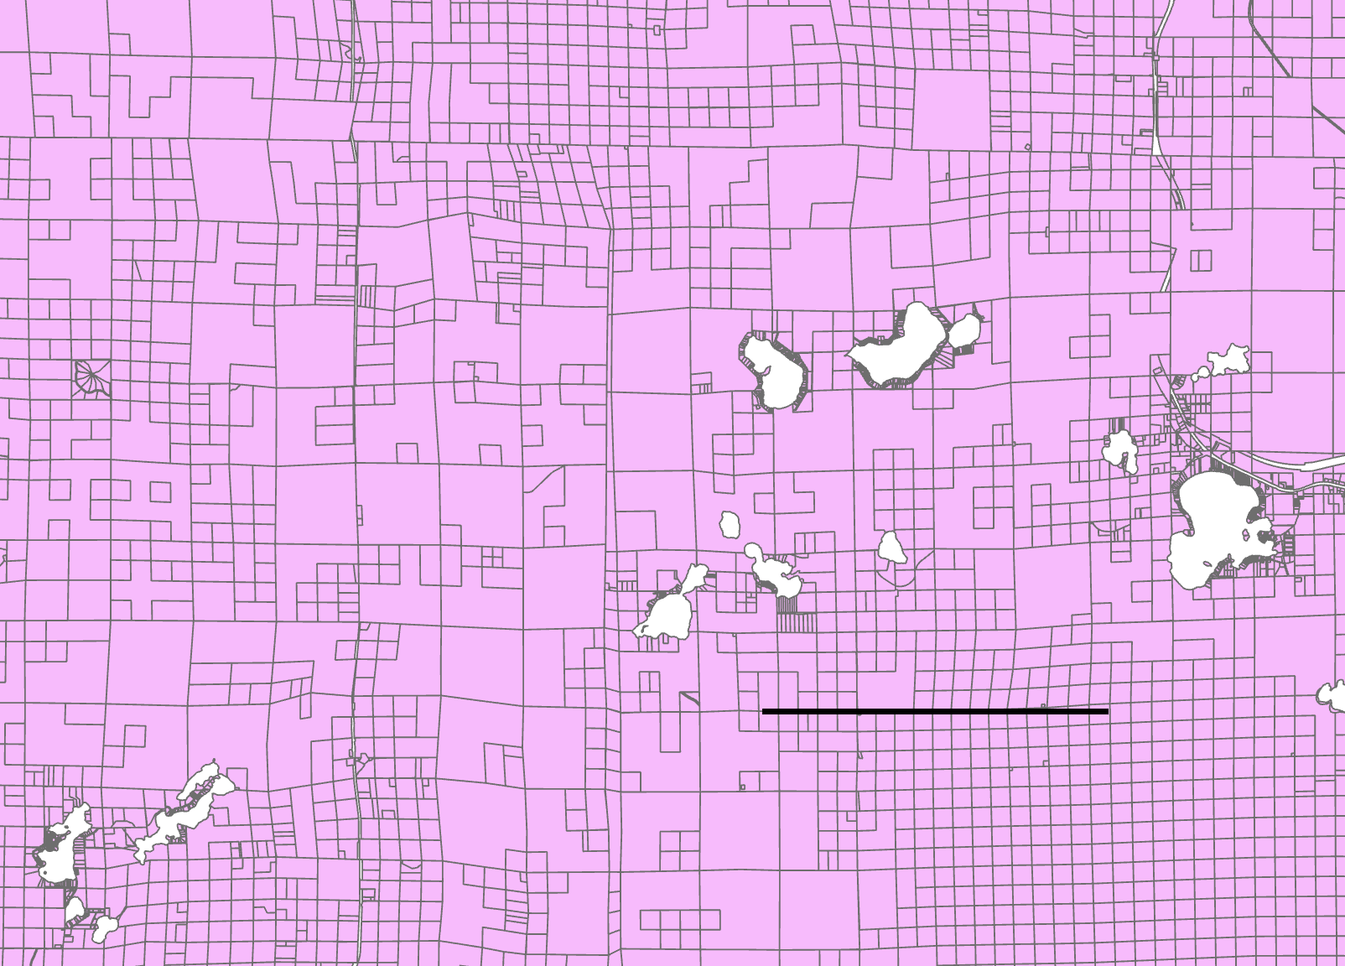
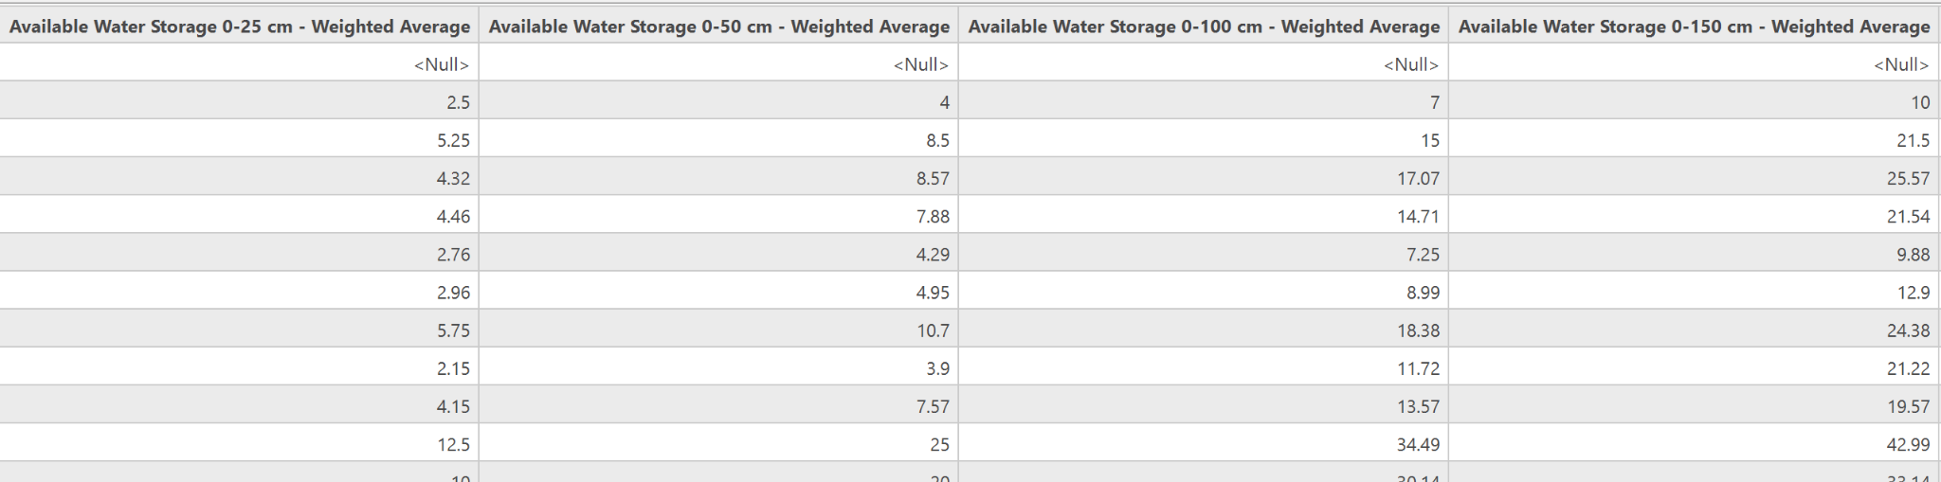
Objective 2. Input Data
gSSURGO dataset – Available Water Storage 0-25cm; 0-50cm; 0-100cm; 0-150cm (‘MUGGATT’ table)
MN (Statewide) County Parcel Dataset
10km

Slide 21
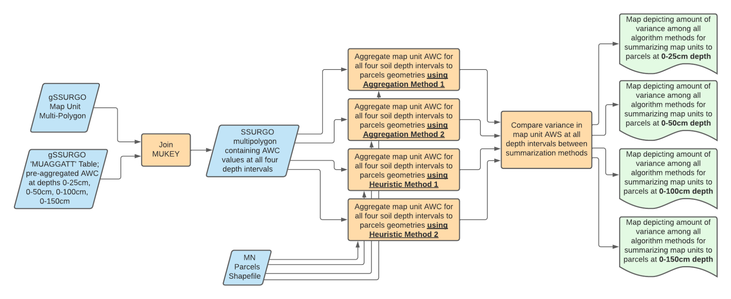
Objective 2. Methodology

Slide 22
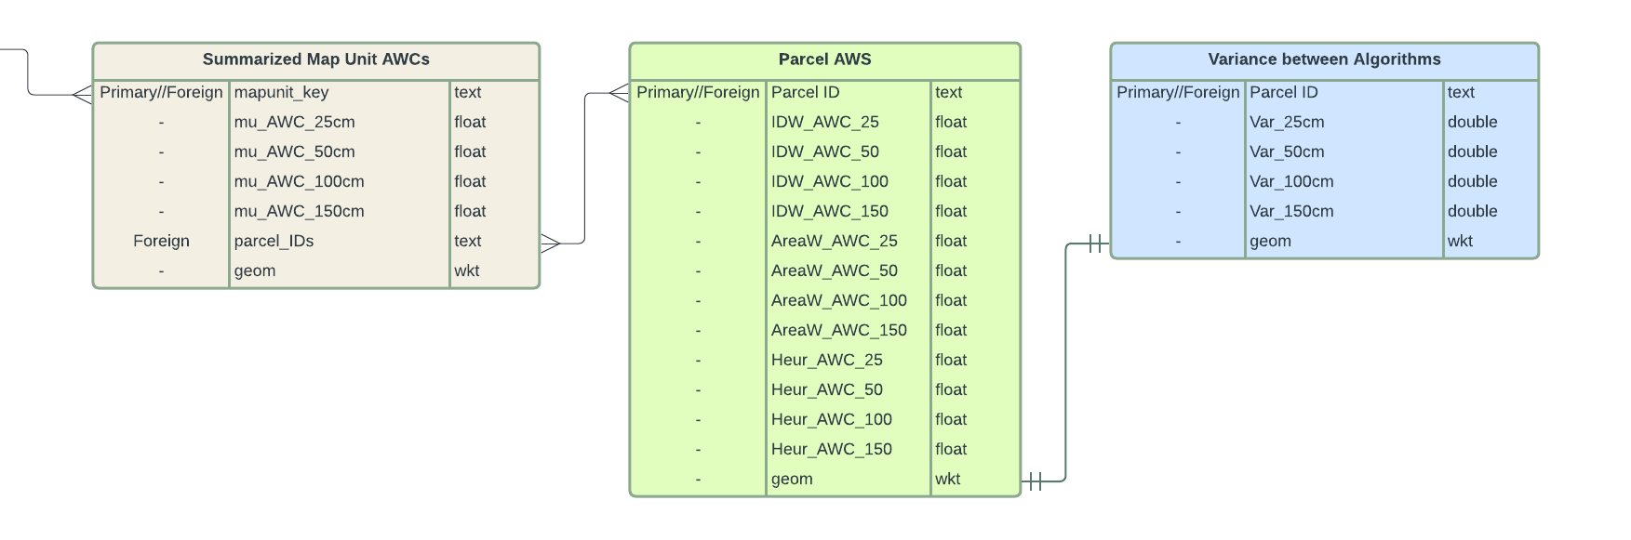
Objective 2. Methodology

Slide 23
Objective 2. Expected Outcomes
0-25cm soil depth
0-50cm soil depth
Understanding how different algorithms for summarizing MUkey polygons to parcel geometries vary AWS calculations
Understanding role of spatial variation within parcels in these categories
Understanding how these calculations may be influenced by soil depth interval.
 | IDW | AWC | (other algorit-hm) | Parcel Size (acres)
Parcel 1 AWS | 4.55 | 6.82 | 4.71 | 220
Parcel 2 AWS | 3.45 | 4.55 | 8.90 | 3000
… | 6.811 | 7.9 | 4.32 | 610
 | IDW | AWC | (other algorit-hm) | Parcel Size (acres)
Parcel 1 AWS | 2.75 | 4.36 | 5.62 | 160
Parcel 2 AWS | 4.1 | 5.24 | 4.39 | 2880
… | 6.31 | 8.9 | 7.94 | 520
Total variance
between algorithms =
Total variance within algorithm/size categories caused by variations in
depth =
Total variance within categories from spatial variation in plot size=

